Slide 2
The Bot Framework
Jennifer Marsman
Principal Software Development Engineer
Microsoft Corporation
http://blogs.msdn.microsoft.com/jennifer
Twitter: @JenniferMarsman

Slide 3
Session Goals
Learn how to build bots (the coding stuff)
Learn how to build *good* bots (the design stuff)

Slide 4
Agenda
Bot Framework Architecture and Channels
Dialogs
State Service
Form Flow
QnA Maker
Scorable Groups
Bot Design
Resources

Slide 5

Architecture of a typical bot
Conversation Canvas/Channels
Web Chat
Your code goes here
Email
Bot Connector Service
Facebook
Message input <> output
State Management
GroupMe
Your bot code
Kik
Bot Builder SDK
Skype
Slack
Bot Builder SDK
API, SDK calls
Telegram
+ Intelligent Services
Twilio (SMS)
Other services, APIs,
Databases, Azure Machine Learning, Azure Search, etc…
Natural Language
Translation
Bot Clipboard w entities
User Preferences
Teams
…
Direct Line…
Speech
Entity Extraction
Bing Knowledge
Image Intelligence
…
…
…
Notes:
Talk about how your bot code needs to be in a publicly-accessible URL

Slide 6
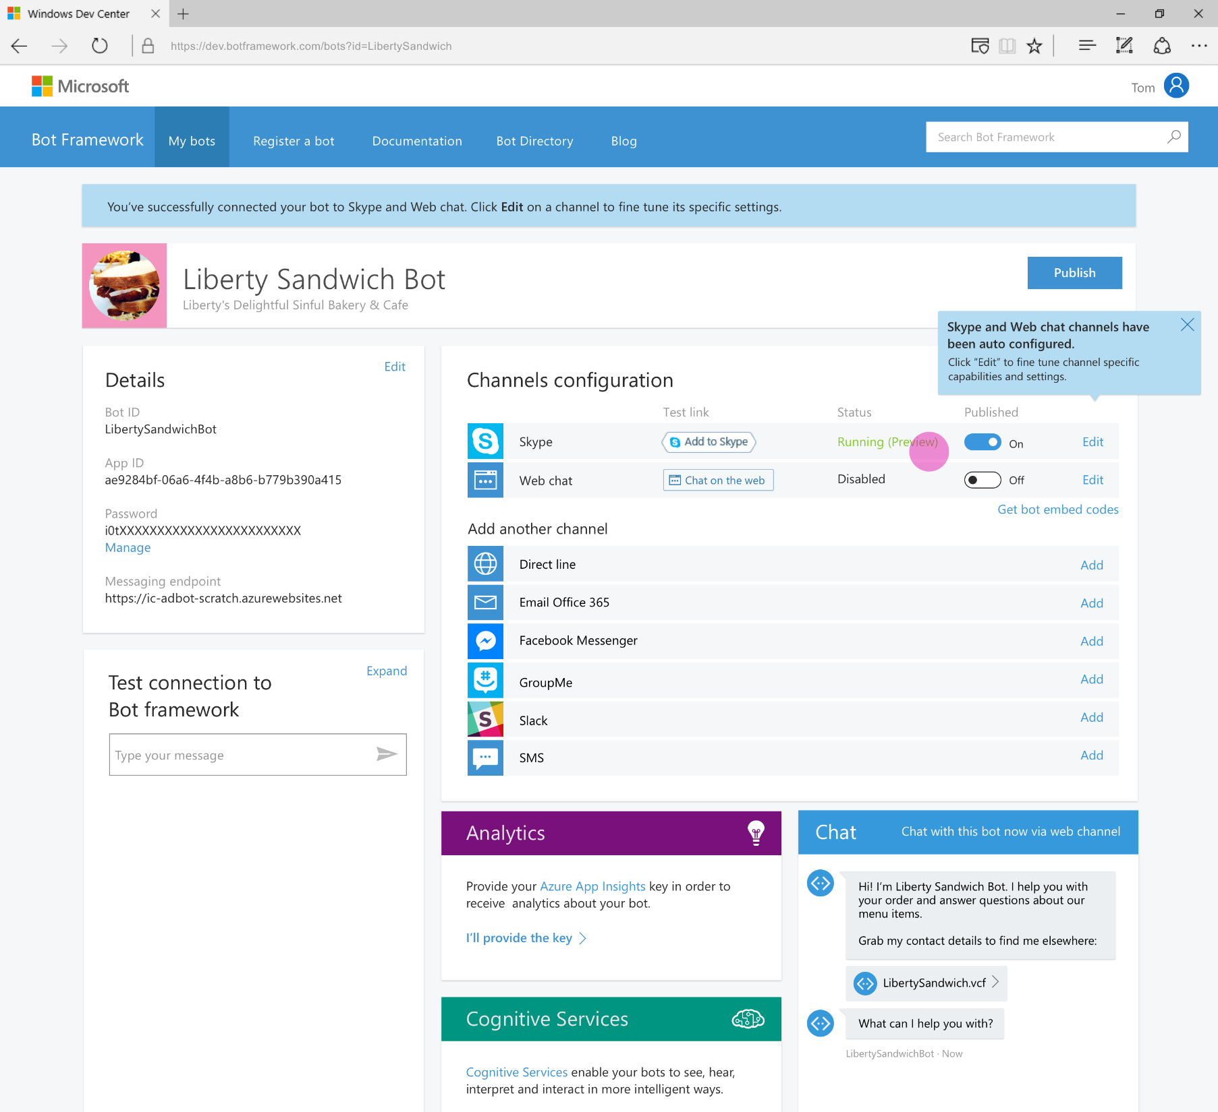
Developer Portal
Register your bot
Connect to channels
Test
Publish
Manage
Measure
Notes:
TODO: replace screenshot

Slide 7
Demo
EchoBot (in Visual Studio Bot Application project template)

Slide 8
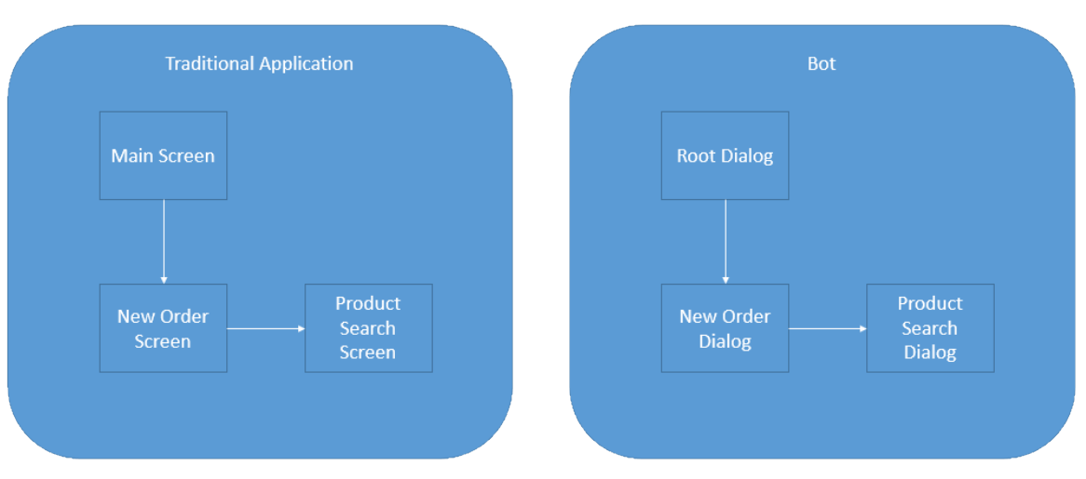
Dialogs are for bots like screens are for apps
They separate concerns and organize flows, exactly the same way:
Read more:
https://docs.microsoft.com/en-us/bot-framework/bot-design-conversation-flow

Slide 9
Invoking a Dialog – C#
public class MessagesController : ApiController
{
public async Task<HttpResponseMessage> Post([FromBody]Activity activity)
{
//controller redirects to RootDialog
await Conversation.SendAsync(activity, () => new RootDialog());

Slide 10
Invoking a Dialog – Node
var server = restify.createServer();
server.listen(process.env.port || process.env.PORT || 3978, function () { });
var connector = new builder.ChatConnector({
appId: process.env.MICROSOFT_APP_ID,
appPassword: process.env.MICROSOFT_APP_PASSWORD
});
var bot = new builder.UniversalBot(connector);
server.post('/api/messages', connector.listen());
// Root dialog
bot.dialog('/', ...

Slide 11
Dialogs are serialized into stacks
Root Dialog
This is how we know how to navigate “back”
Users won’t necessarily think that way
Dialog 1
Dialog 2
…

Slide 12
Redirecting to a Dialog – C#
public virtual async Task MessageReceivedAsync(IDialogContext context, IAwaitable<IMessageActivity> result)
{
var message = await result; //We've got a message!
if (message.Text.ToLower().Contains("order"))
{
//User said 'order'. Let's invoke the New Order Dialog and wait for it to finish
//Then, we will call the ResumeAfterNewOrderDialog
await context.Forward(new NewOrderDialog(), this.ResumeAfterNewOrderDialog, message, CancellationToken.None);
}
//User typed something else so for simplicity we will just ignore
//and keep waiting for the next message
context.Wait(this.MessageReceivedAsync);
}

Slide 13
Redirecting to a Dialog – Node
bot.dialog('/', new builder.IntentDialog()
//Did the user type 'order'?
.matchesAny([/order/i], [
function (session) {
//Let's invoke then the new order dialog
session.beginDialog('/newOrder');
},
function (session, result) {
//This will get us whatever the new order dialog decided to return to us
var resultFromNewOrder = result.response;
session.send('New order dialog just told me this: %s', resultFromNewOrder');
//We are now done with the root dialog
session.endDialog();
}
])

Slide 14


Prompt types
PromptDialog.Attachment()
PromptDialog.Choice()
PromptDialog.Confirm()
PromptDialog.Number()
PromptDialog.Text()

Slide 15
Persisting Data
Bot State Service: https://docs.botframework.com/en-us/csharp/builder/sdkreference/stateapi.html
UserData
Stores information globally for the user across all conversations.
ConversationData
Stores information globally for a single conversation. This data is visible to everyone within the conversation so care should be used to what’s stored there. It’s disabled by default and needs to be enabled using the bots persistConversationData setting.
PrivateConversationData
Stores information globally for a single conversation but its private data for the current user. This data spans all dialogs so it’s useful for storing temporary state that you want cleaned up when the conversation ends.
Notes:
dialogData
Persists information for a single dialog instance. This is essential for storing temporary information in between the steps of a waterfall.

Slide 16
Where is state stored?
The Bot Framework has a default implementation, but you can override it with a custom storage solution if you choose.
IBotState interface in the Bot Connector:
Connector stores data in Azure, encrypted at rest and does not intentionally expire
Emulator provides an in-memory implementation of interface for debugging. This data expires when the emulator process exits.
If you want to store in your datacenters:
Custom IBotState service in the REST layer
Builder interfaces in the language (node or C#) layer
Notes:
https://docs.botframework.com/en-us/technical-faq/#where-is-conversation-state-stored

Slide 17
FormFlow (C# only)
Bot can guide you through wizard-type conversation where user needs to essentially fill out form
Custom prompts for missing information
Validation of inputs
You provide data and it creates the conversation
Asks clarifying questions when needed
Provides navigation between the steps
Notes:
From https://docs.botframework.com/en-us/csharp/builder/sdkreference/forms.html:
At this point, the form is completed and will be returned to the parent dialog. Throughout this interaction you can see that the automatically generated conversation:
Provided clear guidance and help
Understands both numbers and textual entries
Gives feedback on what is understood and what is not.
Asks clarifying questions when needed.
Allows navigating between the steps.
All of this is pretty amazing for not having to do any of the work! However, not every interaction was as good as you might want it to be. That is why there are easy ways to provide:
Messages during the process of filling in a form.
Custom prompts per field.
Templates to use when automatically generating prompts or help.
Terms to match on.
Whether to show choices and numbers or not.
Fields that are optional.
Conditional fields.
Value validation
and much more...

Slide 18
FormFlow: The power of guided conversation
[Describe] Change how a field or a value is shown in a template as a choice or in a card.
[Numeric] Provide limits on the values accepted in a numeric field.
[Optional] Mark a field as optional which means that one choice is not to supply a value.
[Pattern] Define a regular expression to validate a string field.
[Prompt] Define a prompt to use when asking for a field.
[Template] Define a template that is used to generate prompts or values in prompts.
[Terms] Define the input terms that match a field or value.

Slide 19
Demo
Annotated Sandwich Bot

Slide 20
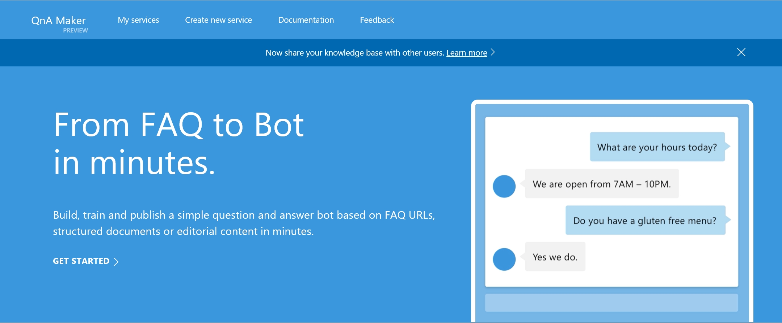
QnA Maker
Autogeneration of conversation logic from FAQ
http://qnamaker.ai
Notes:
https://careers.microsoft.com/help/faq

Slide 21
Scorable Groups
Help with managing working with multiple services: LUIS, QnAMaker, Azure Search, etc.
[RegexPattern("^hello")]
[RegexPattern("^hi")]
[ScorableGroup(0)]
public async Task Hello(IDialogContext context, IActivity activity)
{
await context.PostAsync("Hello! I am a Photo Organization Bot.
I can search your photos, share your photos on Twitter, and
order prints of your photos.");
}

Slide 22
Demo
PictureBot from CognitiveServicesTutorial

Slide 23
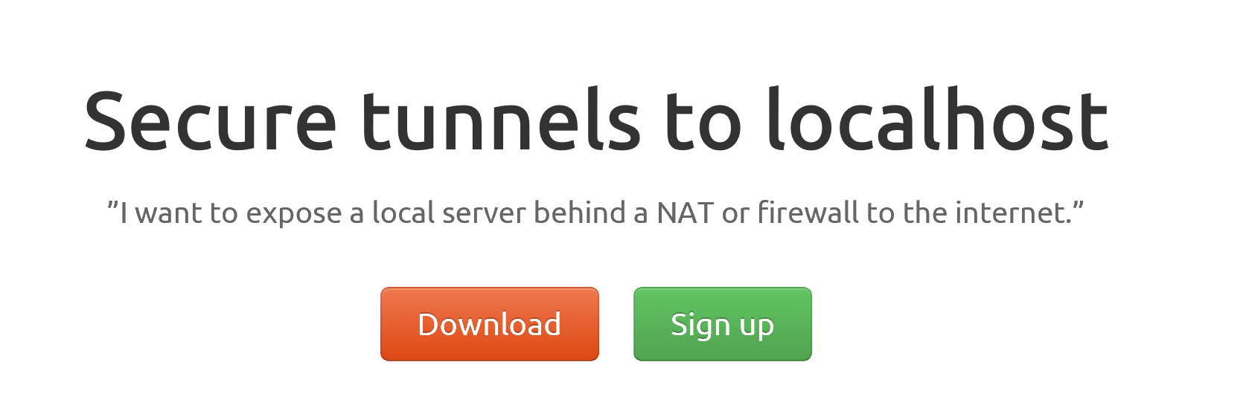
ngrok

Slide 24
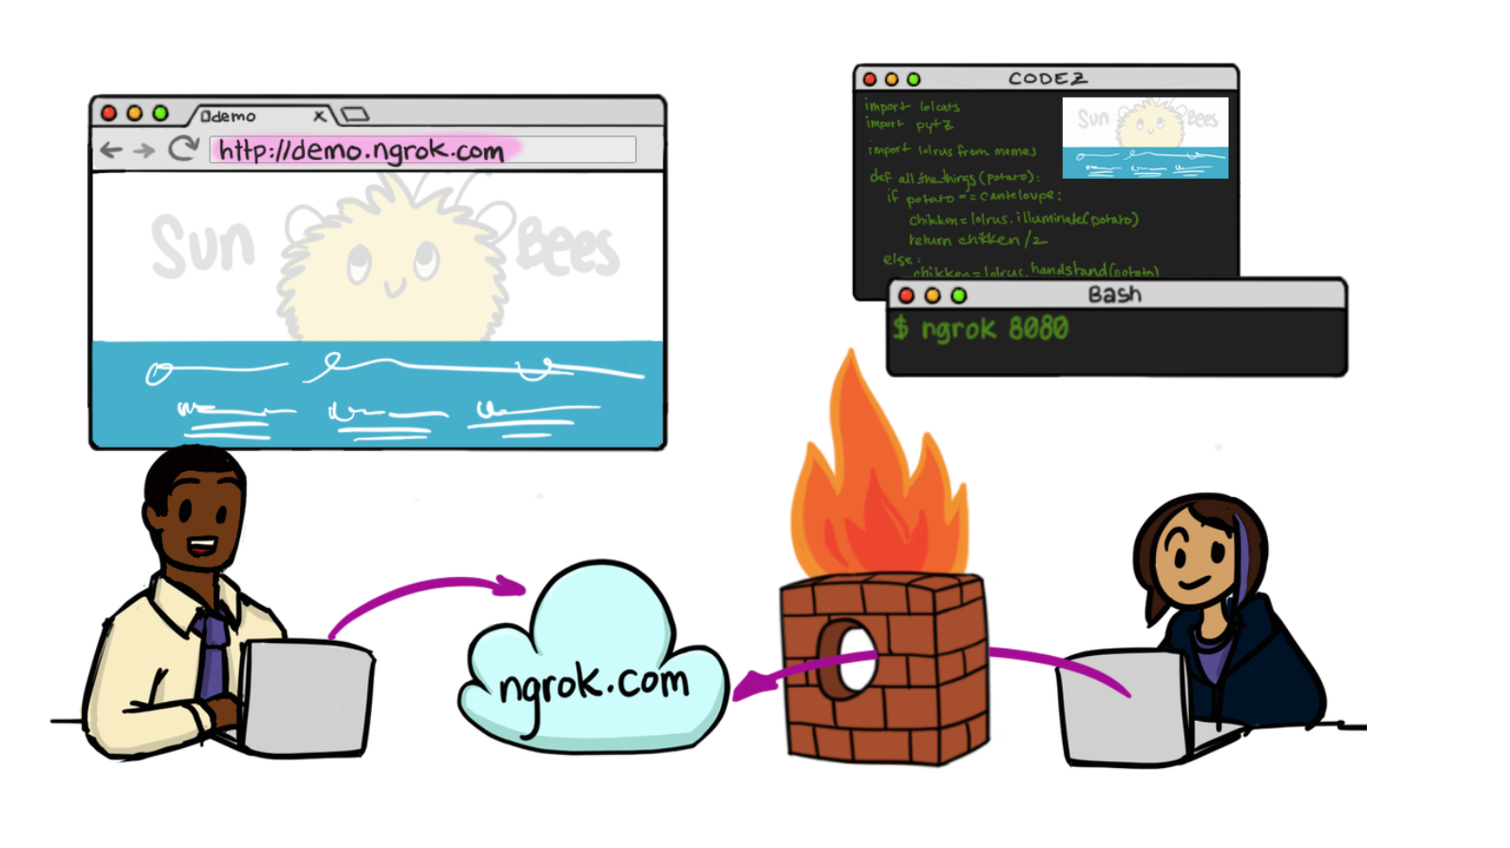

Slide 25
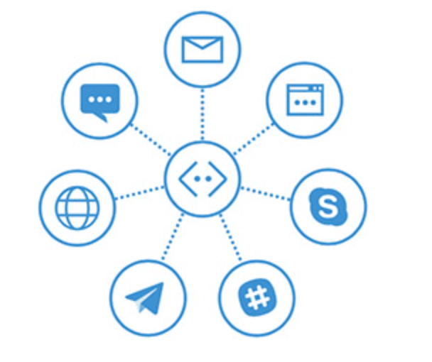
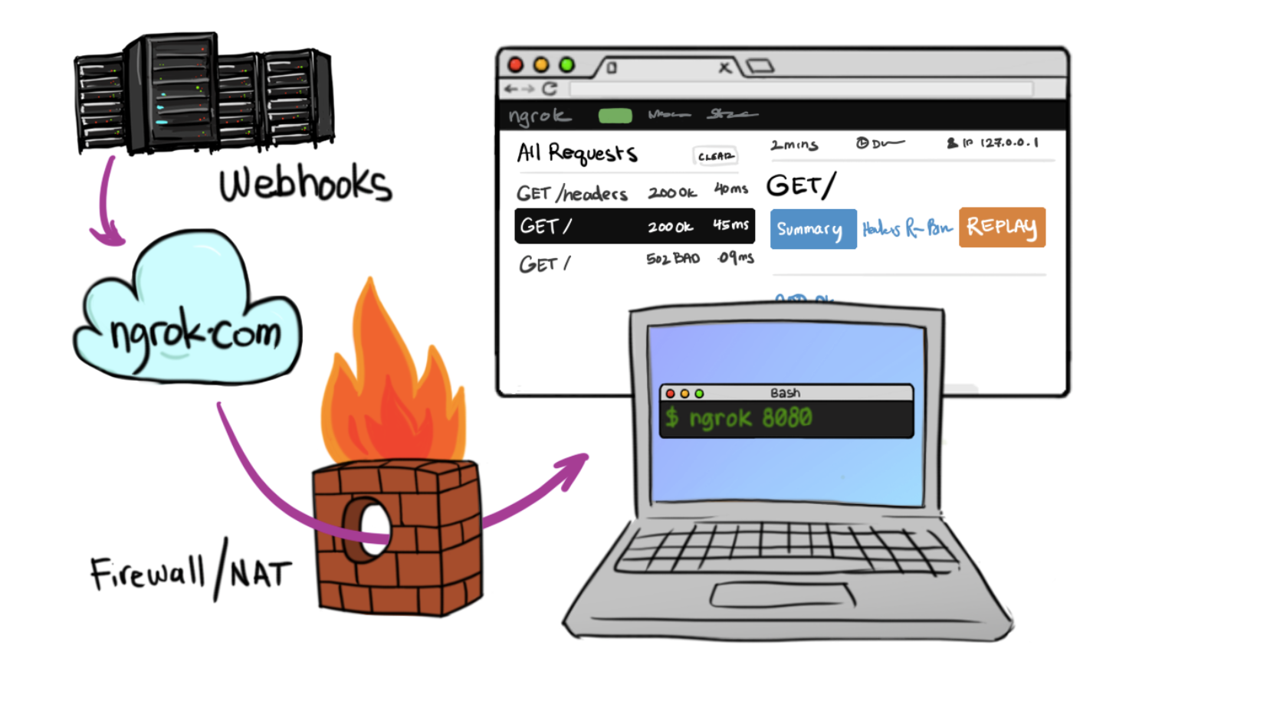
In Cloud
BotFramework

Slide 26
Bot Design
http://aka.ms/botdesign

Slide 27
Build a bot with a clear purpose
What makes a bot great:
It is not how much AI it has
It is not how much natural language it offers
It is not whether it uses voice or not
It’s one thing:
It solves the user’s needs in the quickest/easiest way compared to any other option
...like an app, or a website

Slide 28
Fact #1: New bot developers tend to abuse NLP
A bot with a single dialog using 100 LUIS intents is a bad design:
One question
100 LUIS intents, * 100 different utterances per intent = 10000 different things users may say (plus the other 90000 possibilities you didn’t predict)
100 different things your bot can do
Users will only guess 3 or so
So you just wasted 97% of your code
Hello user! How can I help you?

Slide 29
Fact #1: New bot developers tend to abuse NLP
So instead:
Hello user! How can I help you?
What events are you interested in?
What music would you like? (by the way, next time you could just type “I’m looking for a song named xyz” and I will know what to do)
Events
Music
Stages
Comedy
Amenities
Film
Laser Dome
Spectacles
Guide the user
Save time
Help the user discover what your bot can do
Theater

Slide 30
How LUIS.ai works

Slide 31
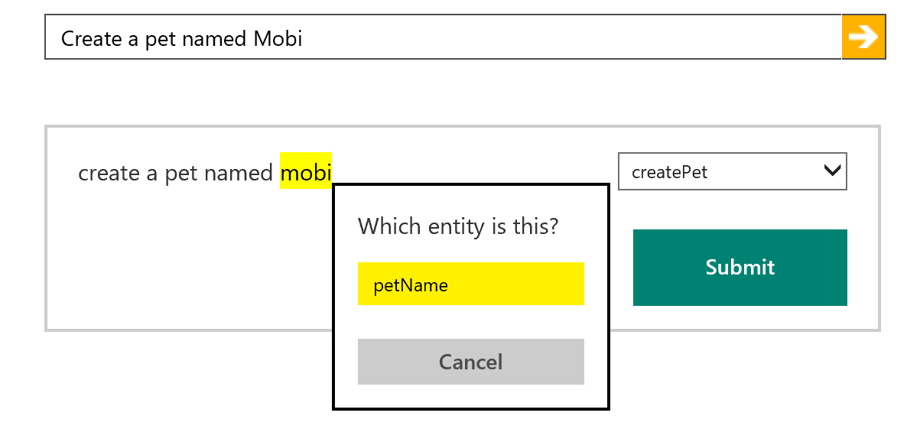
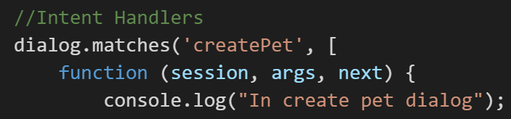
How LUIS.ai works
LUIS.ai
Language Understanding Intelligence Service
Identify entities and intents of messages
Train through GUI or programmatically
Built in LUIS intent handling in bot framework

Slide 32
Important note on LUIS:
If your bot needs 20 LUIS models because of too many intents/entities, then very likely adding 40 won’t fix it. Or 80.
You have a design problem there; brute forcing it won’t help.
Refer to fact #1: New bot developers tend to abuse NLP

Slide 33
Fact #2: Just text or just voice are NOT natural experiences

Slide 34
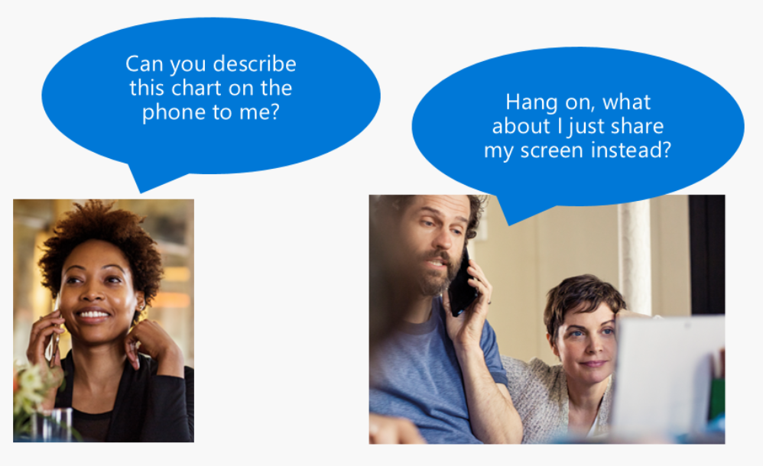
Fact #2: Just text or just voice are NOT natural experiences

Slide 35
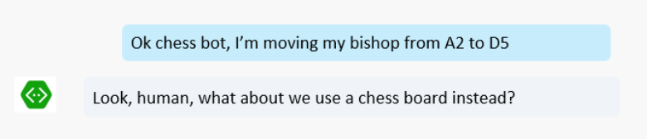
Fact #2: Just text or just voice are NOT natural experiences

Slide 36
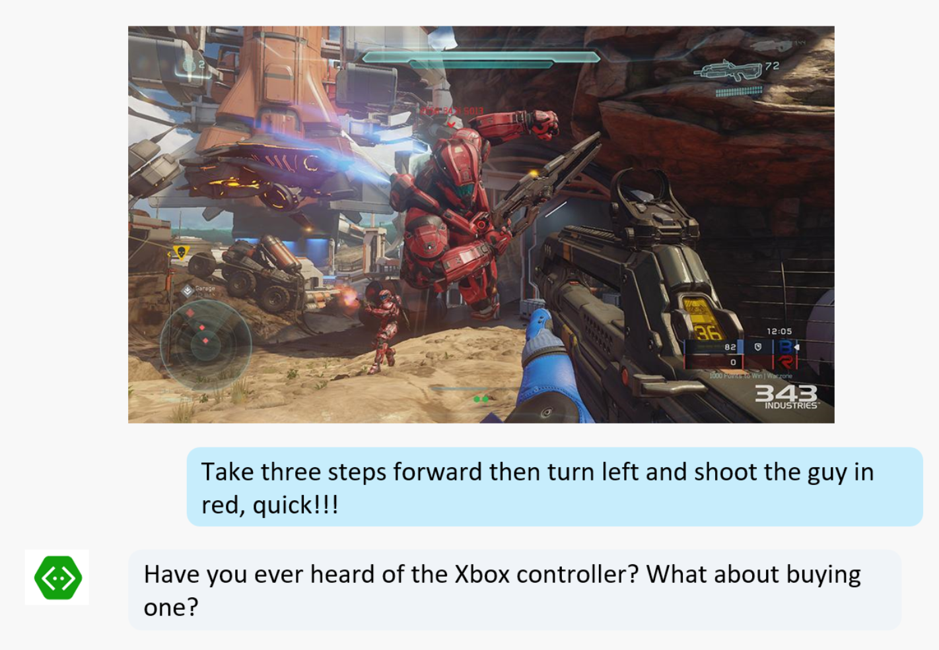
Fact #2: Just text or just voice are NOT natural experiences

Slide 37
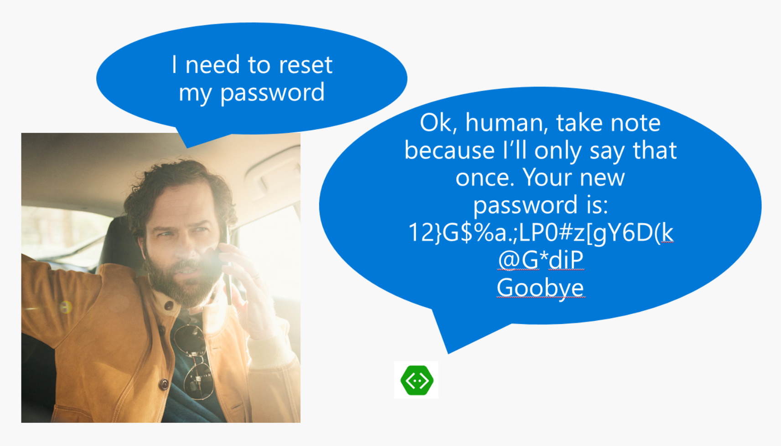
Fact #2: Just text or just voice are NOT natural experiences

Slide 38
Fact #2: Just text or just voice are NOT natural experiences
The world is made of images, movement, sounds, text, symbols, objects… Isolate one and it becomes “unnatural” very quickly.
Again: Focus on the actual user experience. If it feels like it doesn’t make sense, then it probably doesn’t.

Slide 39
Fact #3: Users love buttons
When given the choice of rich controls, text and voice, user will choose:
UI Controls first
Text second
Voice third, only if options above aren’t possible (e.g. Driving a car)

Slide 40
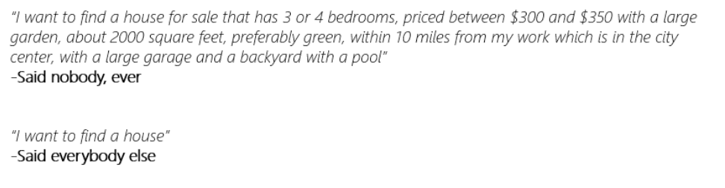
Fact #4: Users never say things the way you expect
As you model your NLP, make sure you’re being realistic.

Slide 41
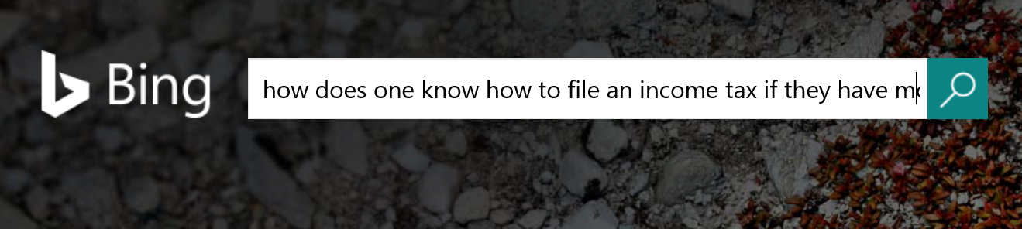
Fact #5: Search can do wonders for bots
Users are often terrible at using search on web
Add search to a bot and now you have a great tool to guide the user into refining their search
Knowledge base, informational, Q&A bots are great scenarios. They typically use QnA Maker and Azure Search for it

Slide 42
Fact #5: Search can do wonders for bots
QnAMaker.ai:
Super low friction way of creating a Q&A bot
Built in web and document crawler: Parses data and builds the QnA easily
Not great for too many records
Not great for deep level customization of the experience
Azure Search:
Can work with millions of records like a breeze
Works with different document formats and data sources
Takes more effort to prepare/code/fine-tune

Slide 43
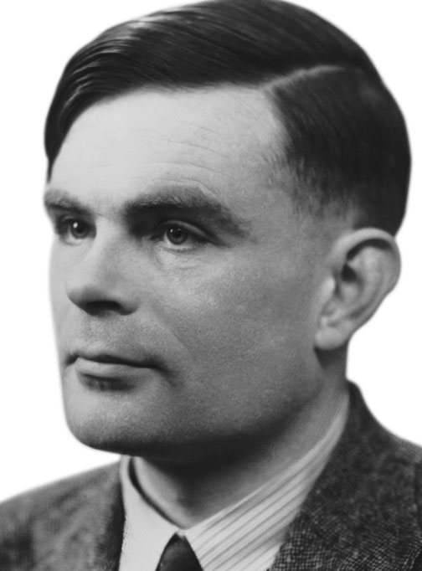
Fact #6: Not all bots need to have conversations
Sometimes buttons do everything you need.
Avoid the engineer’s urge to complicate simple things
Your business requirement is NOT to pass the Turing Test: It is to solve your user’s problem!

Slide 44
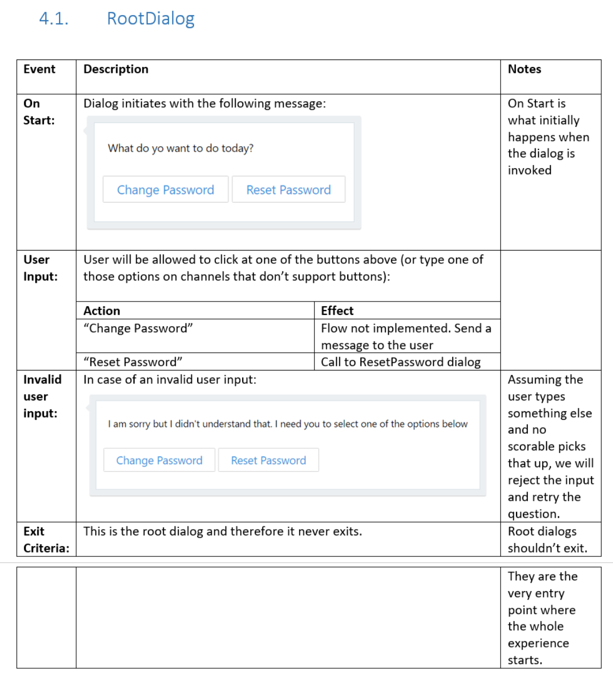
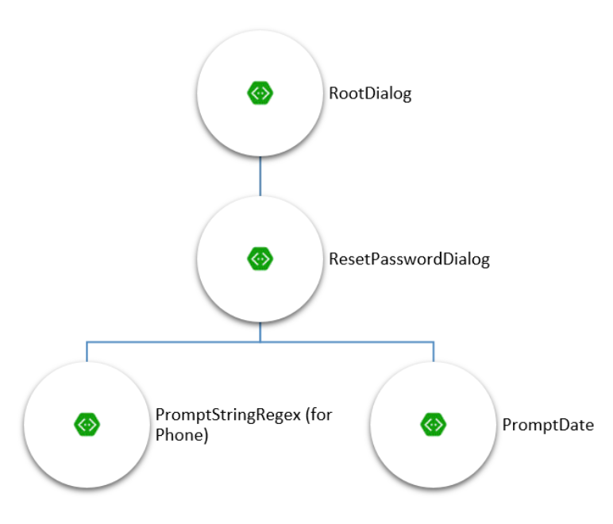
Fact #6: Not all bots need to have conversations
Spec out an “app kind” of bot: https://github.com/MicrosoftDX/botFramework-botSpecDocs/blob/master/src/CaaP%20Design%20spec.docx

Slide 45
Fact #7: No UI is impossible with bots
Even if standard channels can’t do it, you can always build your own UI/App/Web.
Think richer UIs with bots, HoloLens, etc. It is all possible.
Read more:
https://docs.microsoft.com/en-us/bot-framework/bot-design-pattern-embed-app
https://docs.microsoft.com/en-us/bot-framework/bot-design-pattern-embed-web-site

Slide 46
Fact #8: Measurement and logging
If your bot doesn’t collect data and give you ways of understanding what it does well and not, you can’t make it better.
No logging by default
Easy integration with Application Insights

Slide 47
Resources
Developer portal: http://dev.botframework.com
Bot directory: http://bots.botframework.com
Documentation: http://docs.botframework.com
Visual Studio template: http://aka.ms/bf-bc-vstemplate
Bot Framework Emulator: http://emulator.botframework.com
Best sample code: http://aka.ms/JenBotSamples
GitHub repo: http://github.com/Microsoft/BotBuilder

Slide 48
Thank you!
Jennifer Marsman
Principal Software Development Engineer
http://blogs.msdn.microsoft.com/jennifer
Twitter: @JenniferMarsman

